Slide 1
Intro to service oriented distributed systems
Jonas Samuelsson - lead developer @ meps

Slide 2
Why services?
Isolate change
Better business alignment
Organizational scaling
Why distributed systems (microservices)?
Faster time to market
Ability to use the right tool for the job
Improved scalability
Increased resiliency

Slide 3
What a service is not
something that has only functionality is a function, not a service​
like calculation, validation​
something that has only data is a database, not a service​
like [create, read, update, delete] entity
exposing something over http doesn’t make it a service

Slide 4
What is a service?
A service is the technical authority for a specific business capability​
services are autonomous​
all data and business rules reside within the service​
nothing is "left over" after identifying services​, everything must be in some service

Slide 5
Services & systems
services are logical designtime concerns with business aligned boundaries​
systems are physical runtime concerns with technically aligned boundaries​
multiple services can be deployed to the same machine
multiple services can be deployed to the same system
multiple services can cooperated in the same view / workflow
a service can consist of multiple components

Slide 6






Service A
Service B
Service C
System X
System Y
System Z

Slide 7
Finding service boundaries​
dont do high level design, its the details that matters​
dont do entities, if you find yourelf saying 'has a' its might be an indication your thinking about entities​
look at use cases & behaviors​
work bottom up; scenario > field > object​
look for anti requirements, often easier to find​
don't name your services to early​

Slide 8
Customer
FirstName
LastName
Status
Product
Name
Description
Price
CustomerFirstName
CustomerLastName
CustomerStatus
ProductPrice
ProductName
ProductDescription

Slide 9
1
2
3
.

Slide 10
1
2
3

Slide 11
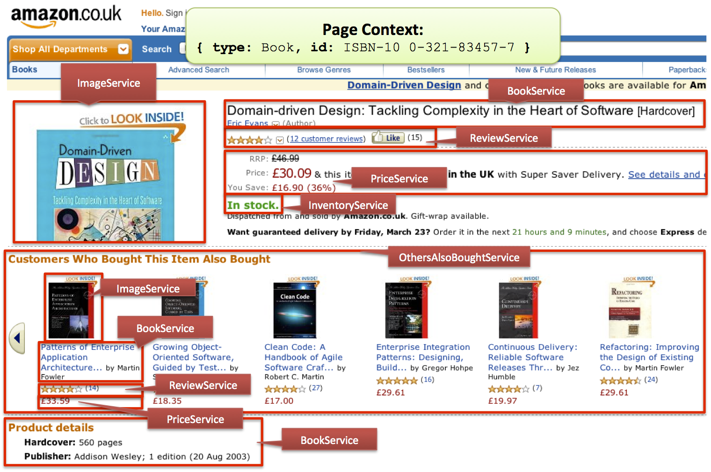

Slide 12
RoomTypeId
From, To
Capacity
BookingId
RoomTypeId
Name
Description
Image
RoomTypeId
From, To
Price
BookingId
GuestInfo
BookingId
RoomId
RoomTypeId
RoomDetails
BookingId

